Slide 1

RedRock Seminar
Design Pattern – Singleton and Builder

Slide 2
Singleton Design Pattern
Definition : The singleton Pattern ensures a class has only one instance, and provides global access to it.
Making a class to manage a single instance of itself.
Preventing any other class from creating a new instance on its own
To get an instance you have to go through the class itself.
Providing a global access point to instance: Whenever you need an instance, just query the class and it will hand you back the single instance.

Slide 3
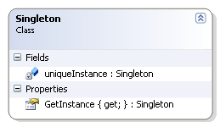
Singleton Design Pattern
Class Diagram
public class Singleton
{
private static Singleton uniqueInstance;
public Singleton GetInstance
{
get
{
if (uniqueInstance == null)
uniqueInstance = new Singleton();
return uniqueInstance;
}
}
// Other Methods
}

Slide 4
Singleton Design Pattern
Multithreaded Singleton
public class Singleton
{
private static Singleton uniqueInstance;
private static object syncRoot = new object();
public Singleton GetInstance
{
get
{
if (uniqueInstance == null)
{
lock(syncRoot)
{
if (uniqueInstance == null)
uniqueInstance = new Singleton();
}
}
return uniqueInstance;
}
}
}

Slide 5
Builder Design Pattern
Purpose : The builder pattern is used to encapsulate the construction of a object and allow it to be constructed in steps.
Reasons :
  Step by Step construction of a target object
  Reduce the size of class that has many methods

Slide 6
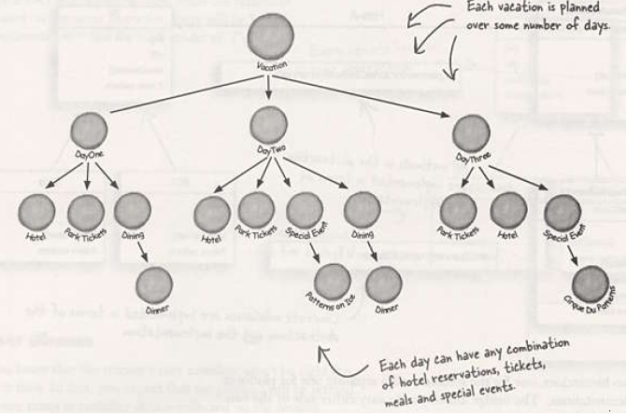
Builder Design Pattern
Scenario

Slide 7
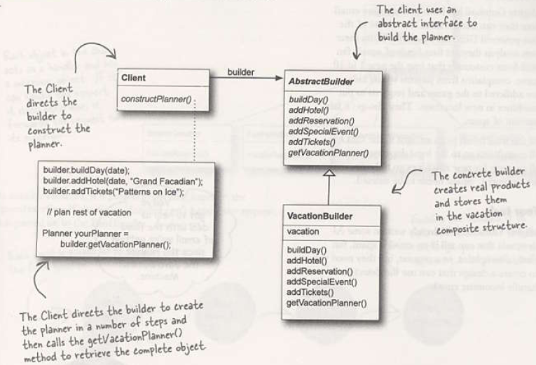
Builder Design Pattern
Class Diagram

Slide 8
Builder Design Pattern
Builder Benefits
Encapsulates the way a complex object is created
Allows object to be constructed in a multi step and varying process
Product implementations can be swapped as client is only sees an abstract interface.
.Net Examples of Builder Pattern
SQLConnectionBuilder
UriBuilder
StringBuilder

Slide 9
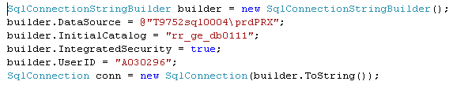
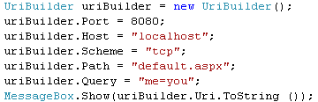
Builder Design Pattern
SqlConnectionStringBuilder
UriBuilder

Slide 10
Resources
Books
  Design Patterns – GOF
  Design Patterns – Christpher G Lasater
  Head First Design Patterns

Slide 11
Questions
If (Questions == null || Questions.Count == 0)
{
Thank you;
}

